Slide 1
Estimation of Actuation Configuration for a Multi-Actuated Blimp
Final Presentation (Semester Thesis)
Students: Matthias Krebs Advisors: Kostas Alexis
Simon Laube Markus Achtelik

Slide 2
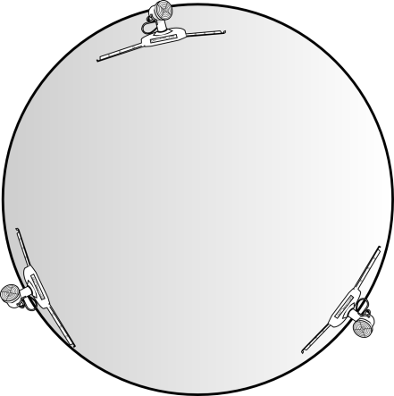

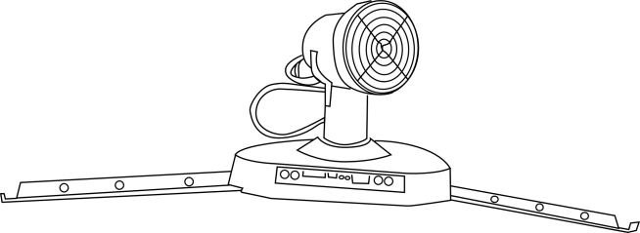

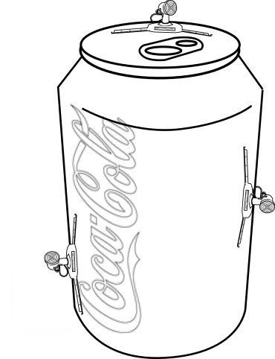
Motivation
One control solution for arbitrary blimpy

Slide 3
Goal

Slide 4
Content
System Overview
Problem Formulation
Parameters
System Model
Input Pattern
Optimization
Results
Simulation Results
Experimental Results
Ground Truth
Conclusion & Outlook

Slide 5
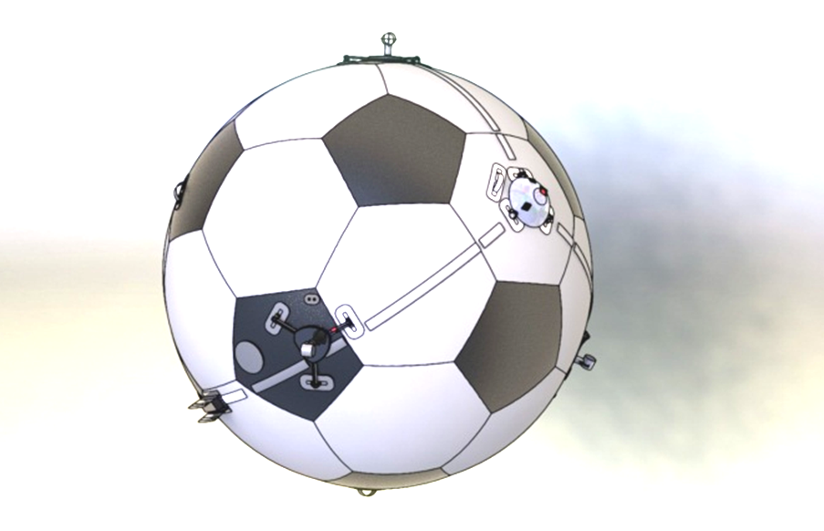
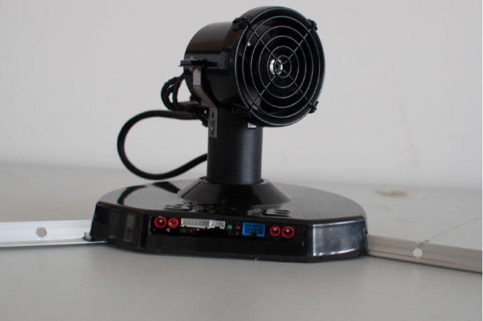
System Overview
Spherical Hull filled with Helium
4 Actuation Units (AU)
Electronics:
IMU
Controller
XBee
Rotation
Thrust

Slide 6
System Overview: Control
Independent of Actuators
Depends on Actuators

Slide 7
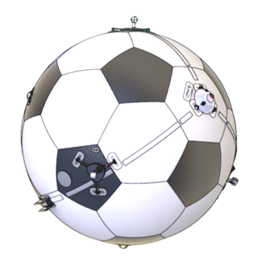
System Overview
Controller
System
Controller
Allocation
Actuation
Body Dynamics
3
4
3
4
4
Setpoint
F_{Blimp}
F_{Motors}
F_{Motors}
3
4
3
4
4
M_{Blimp}
α_{Motors}
α_{Motors}
4
Encoder
State Estimation

Slide 8
Problem Formulation
IMU Data
Actuator Input Pattern .
Parameter
Optimization Algorithm
Model
Model Output

Slide 9
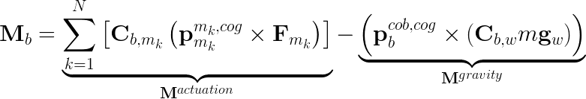
Problem Formulation: System Model
Angular Acceleration
with
Aerodynamic effects on rotation neglected (M^{aero} << M^{actuation})
Notes:
Halbwertszeit der Rotation ist ca. 50 sec

Slide 10
Problem Formulation: Parameters
Actuator Arrangement
Actuator Arrangement
Actuator Arrangement
Actuator Arrangement
Orientation SO(3)
Center of Gravity R³
Mass R
Position R³
Inertia Tensor Sym(3)
Radius
R
e.g. Drag Torque would be another jointly observable param
Full Parameter set is only jointly observable

Slide 11
Problem Formulation: Parameters
Actuator Arrangement
Actuator Arrangement
Actuator Arrangement
Actuator Arrangement
Orientation SO(3)
Center of Gravity R³
Mass R
Position R³
Inertia Tensor Sym(3)
Radius
R
Position is assumed to be on sphere
Radius and mass are assumed to be known (scales J & cog)

Slide 12
Problem Formulation: System Model
Angular Acceleration
with

Slide 13
Simulator
Object oriented simulator in Matlab
Modular concept for (almost) arbitrary blimps
Assembly
parts, Hamiltonians, …
Simplified view
Skye
Part
mass, dimension, drag coeff., …
Hull
AU
EP
AU
AU
AU
IMU
Cam
Actuator
States, active forces …
Accu
Rot
Simulator
Dataset

Slide 14
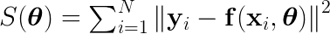
Problem Formulation: Optimization
Nonlinear Least Squares
Levenberg-Marquardt
Gradient based minimization
Robust and fast convergence

Slide 15
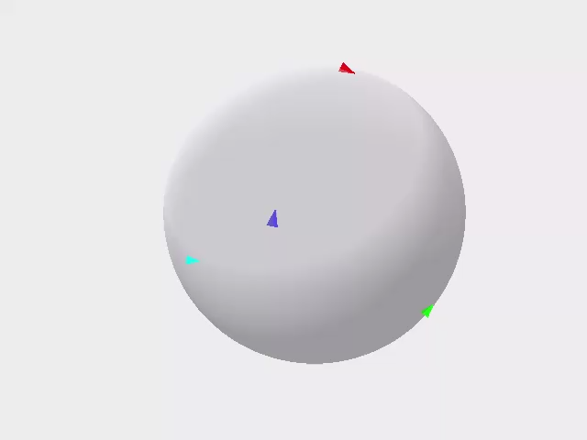
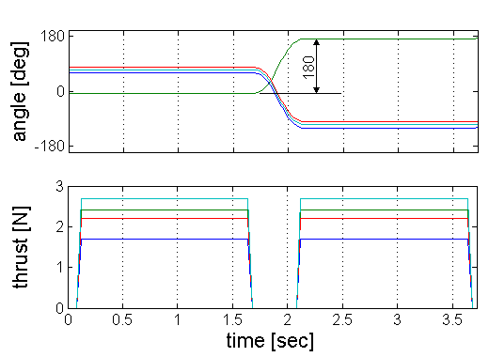
Problem Formulation: Input Pattern
Inputs must be applicable and sufficiently excited
Apply sequence of forward/backward force patterns in varying directions for all actuation units
Steady state motor dynamics

Slide 16
Results
Simulation Results
Confidence Region
Convergence Region
Casestudies
Experimental Results
Groundtruth with Leica

Slide 17
Simulation: Confidence Region
Zeige Konvergenz & Anzahl Iterationen mit LMA

Slide 18
Simulation: Casestudies
mean | AU4 x | AU4 y | J | cog
4 AUs | 6.18e-04 | 7.66e-04 | 6.12e-02 | 6.94e-05
No drag | -4.89e-04 | 1.38e-03 | 5.16e-02 | 1.81e-05
Single AU
Resnorm [rad/s2]
6.73e-04
6.88e-04
std | AU4 x | AU4 y | J | cog
4 AUs | 3.65e-03 | 7.19e-03 | 3.00e-02 | 1.35e-04
No drag | 4.29e-03 | 7.96e-03 | 3.35e-02 | 1.21e-04
32 simulations à 2000 raw datapoints

Slide 19
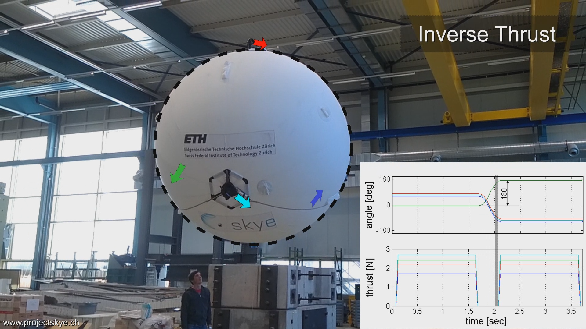

Problem Formulation: Input Pattern

Slide 20
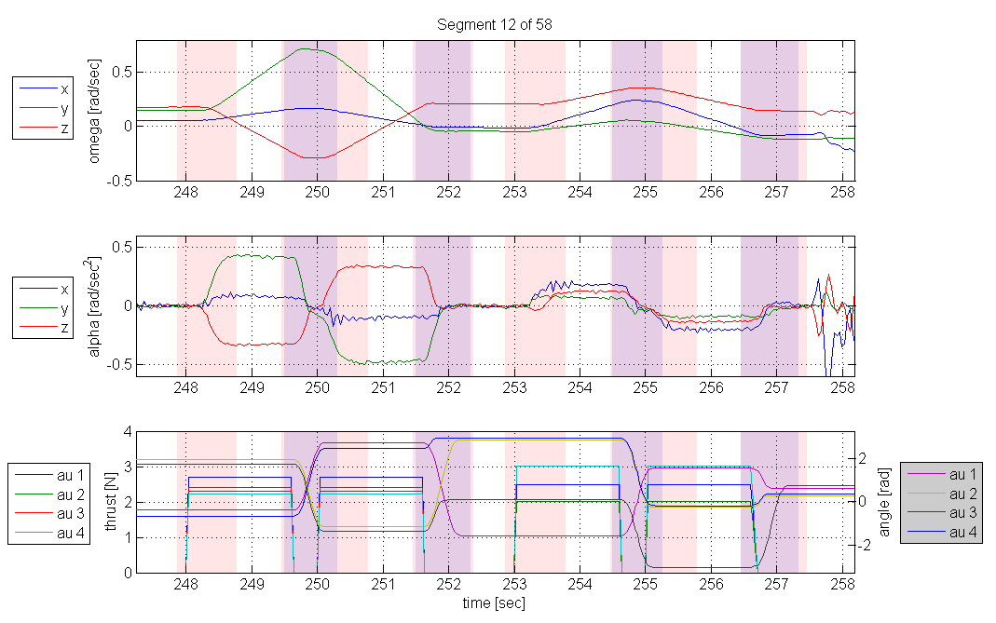
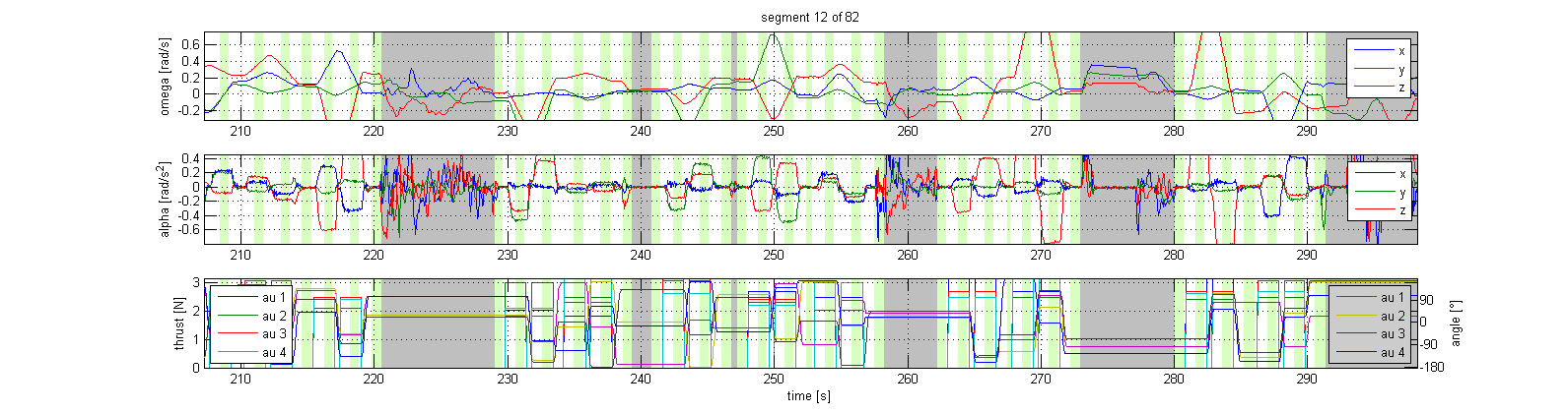
Data Acquisition (Preprocessing)
Disturbance:
Remove manually

Slide 21
Results: Experiments

Slide 22
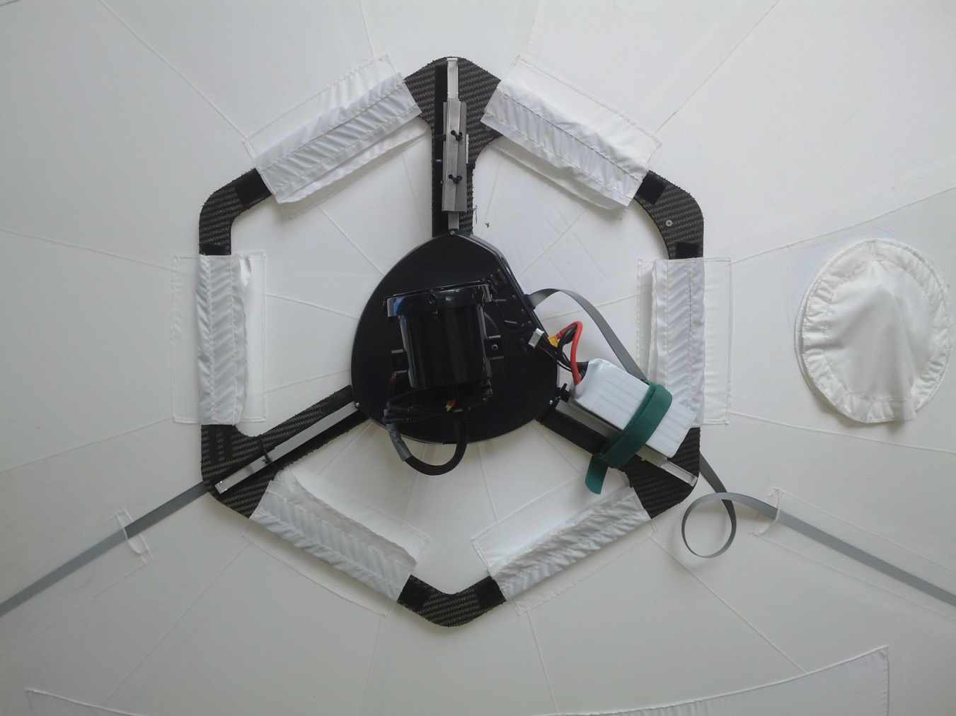
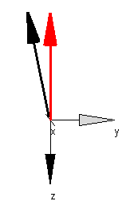
Experiments

Slide 23
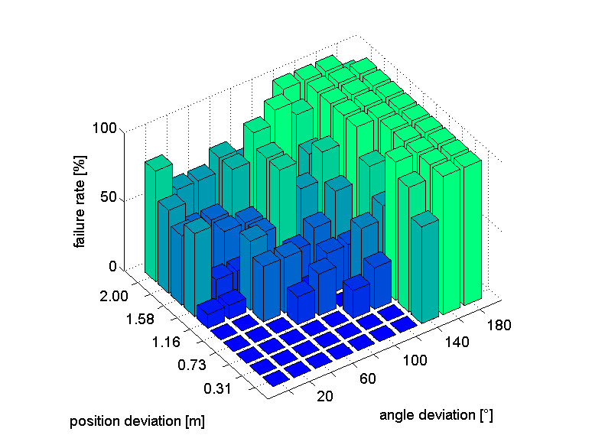
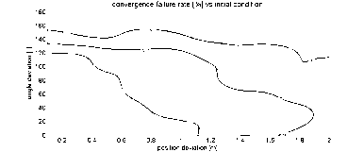
Simulation: Convergence Region
Initial Parameters can be about 1m or 120° apart of the true value

Slide 24
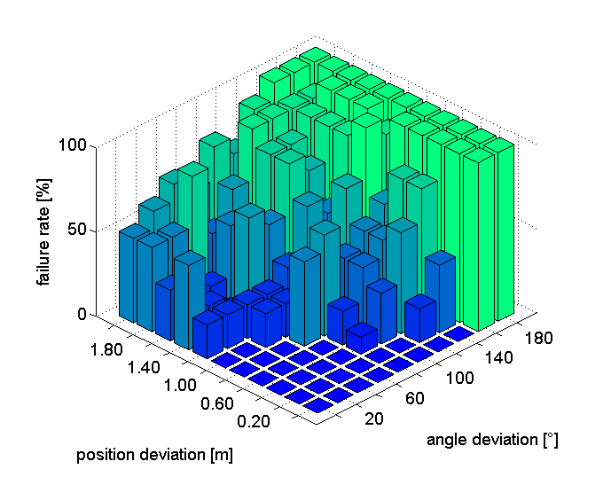
Experiment: Convergence Region
Initial Parameters can be about 1m or 120° apart of the true value

Slide 25
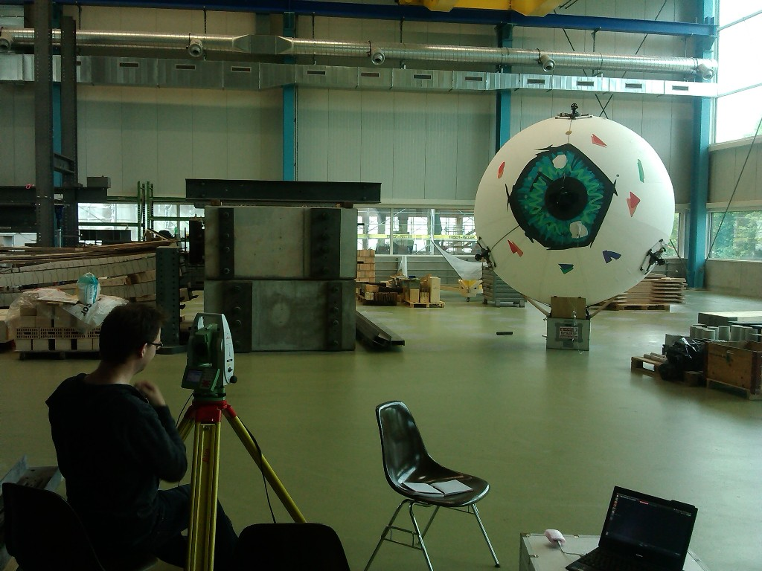
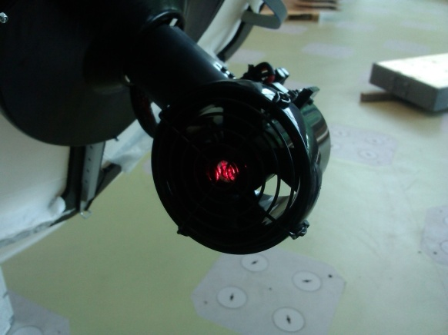
Results: „Ground Truth“ (Leica)
3 AU‘s visible at once
Use different views
Fit data to get tetrahedral‘s edge length
Residual below 0.01m

Slide 26
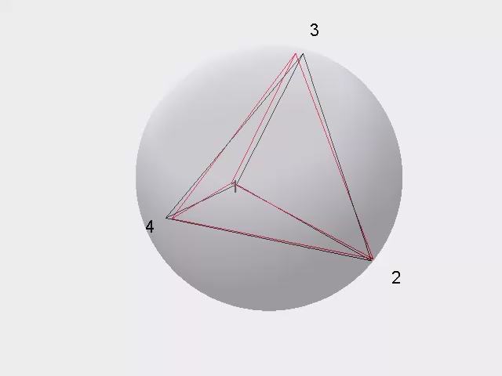
Results: Compare Leica and Batch Solution
Compare tetrahedral edge length
Relative error of batch solution
% | AU2 | AU3 | AU4
AU1 | 1.68 | 0.86 | 2.76
AU2 |  | 0.67 | 2.47
AU3 |  |  | 3.78
Leica
Batch

Slide 27
Discussion
To be done!
How can data be used

Slide 28
Outlook
To be done
Use data for allocation
Best length of input patterns
Use it for different Blimps

